Slide 1
Mobile Analysis - 2023

Slide 2
Project description :-
Developed a real-time mobile analytics dashboard to track and evaluate transaction data, leveraging SQL for efficient data management.
Designed and implemented a SQL database and automated workflows for seamless data import and transformation from CSV files.
Utilized Power BI to create detailed visualizations, offering insights into customer spending patterns and demographics.
Provided actionable insights by aiding strategic decision-making.

Slide 3
AT SQL QUERY :- Find out the below query to understand the data
Check mobile feature and price list
Find out the price of 5 most expensive phones
Find out the price of 5 most cheapest phones
List of top 5 Samsung phones with price and all features
Must have android phones list then top 5 high price android phone
Must have android phones list then top 5 lower price android phone
Must have IOS phone list then top 5 high price IOS phones
Must have IOS phone list then top 5 lower price IOS phones
Write a query which phone support 5G and also top 5 phone with 5G support
Total price of all mobiles is to be found with brand name

Slide 4
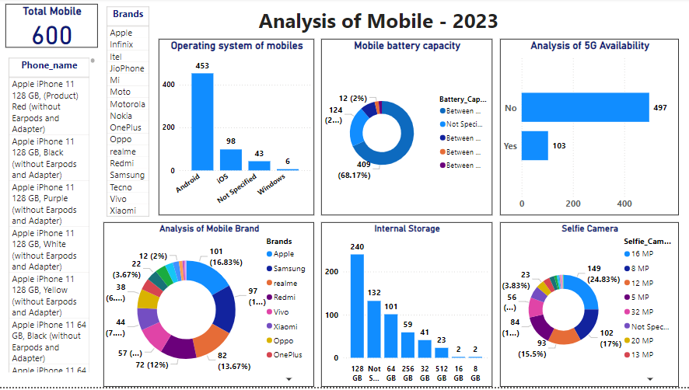
Power BI Dashboard Creation

